Slide 1
Topic name
Introduction to Transaction Processing, Properties of Transactions, States of
transactions, Schedule.
Department of Computer Science and Engineering,
Chitkara University, Himachal Pradesh

Slide 2
TRANSACTION
The transaction is a set of logically related operation. It contains a group of tasks.
A transaction is an action or series of actions. It is performed by a single user to perform operations for accessing the contents of the database.

Slide 3
EXAMPLE
Example: Suppose an employee of bank transfers Rs 800 from X's account to Y's account. This small transaction contains several low-level tasks:
X's Account
Open_Account(X)
Old_Balance = X.balance
New_Balance = Old_Balance - 800
X.balance = New_Balance
Close_Account(X)
Y's Account
Open_Account(Y)
Old_Balance = Y.balance
New_Balance = Old_Balance + 800
Y.balance = New_Balance
Close_Account(Y)

Slide 4
Operations of Transaction:
Read(X): Read operation is used to read the value of X from the database and stores it in a buffer in main memory.

Slide 5
Write(X): Write operation is used to write the value back to the database from the buffer.
Let's take an example to debit transaction from an account which consists of following operations:
1. R(X);
2. X = X - 500;
3. W(X);
Let's assume the value of X before starting of the transaction is 4000.
The first operation reads X's value from database and stores it in a buffer.
The second operation will decrease the value of X by 500. So buffer will contain 3500.
The third operation will write the buffer's value to the database. So X's final value will be 3500.
But it may be possible that because of the failure of hardware, software or power, etc. that transaction may fail before finished all the operations in the set.

Slide 6
For example: If in the above transaction, the debit transaction fails after executing operation 2 then X's value will remain 4000 in the database which is not acceptable by the bank.
To solve this problem, we have two important operations:
Commit: It is used to save the work done permanently.
Rollback: It is used to undo the work done.

Slide 7
Transaction properties:
The transaction has the four properties. These are used to maintain consistency in a database, before and after the transaction.
Property of Transaction
Atomicity
Consistency
Isolation
Durability

Slide 8
ATOMICITY
It states that all operations of the transaction take place at once if not, the transaction is aborted.
There is no midway, i.e., the transaction cannot occur partially. Each transaction is treated as one unit and either run to completion or is not executed at all.
Atomicity involves the following two operations:
Abort: If a transaction aborts then all the changes made are not visible.
Commit: If a transaction commits then all the changes made are visible.

Slide 9
Example: Let's assume that following transaction T consisting of T1 and T2. A consists of Rs 600 and B consists of Rs 300. Transfer Rs 100 from account A to account B.
T1: Read(A), A:= A-100, Write(A)
T2: Read(B), Y:= Y+100, Write(B)
After completion of the transaction, A consists of Rs 500 and B consists of Rs 400.
If the transaction T fails after the completion of transaction T1 but before completion of transaction T2, then the amount will be deducted from A but not added to B. This shows the inconsistent database state. In order to ensure correctness of database state, the transaction must be executed in entirety.

Slide 10
CONSISTENCY
The integrity constraints are maintained so that the database is consistent before and after the transaction.
The execution of a transaction will leave a database in either its prior stable state or a new stable state.
The consistent property of database states that every transaction sees a consistent database instance.
The transaction is used to transform the database from one consistent state to another consistent state.

Slide 11
For example:
The total amount must be maintained before or after the transaction.
Total before T occurs = 600+300=900
Total after T occurs= 500+400=900
Therefore, the database is consistent. In the case when T1 is completed but T2 fails, then inconsistency will occur.

Slide 12
ISOLATION
It shows that the data which is used at the time of execution of a transaction cannot be used by the second transaction until the first one is completed.
In isolation, if the transaction T1 is being executed and using the data item X, then that data item can't be accessed by any other transaction T2 until the transaction T1 ends.
The concurrency control subsystem of the DBMS enforced the isolation property.

Slide 13
DURABILITY
The durability property is used to indicate the performance of the database's consistent state. It states that the transaction made the permanent changes.
They cannot be lost by the erroneous operation of a faulty transaction or by the system failure. When a transaction is completed, then the database reaches a state known as the consistent state. That consistent state cannot be lost, even in the event of a system's failure. The recovery subsystem of the DBMS has the responsibility of Durability property.

Slide 14
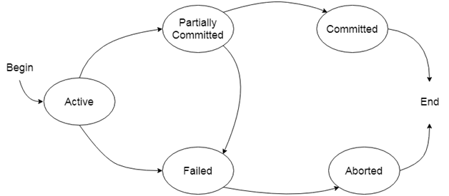
TRANSACTION STATES
In a database, the transaction can be in one of the following states -

Slide 15
Active state
The active state is the first state of every transaction. In this state, the transaction is being executed.
For example: Insertion or deletion or updating a record is done here. But all the records are still not saved to the database.
Partially committed
In the partially committed state, a transaction executes its final operation, but the data is still not saved to the database.
In the total mark calculation example, a final display of the total marks step is executed in this state.
Committed
A transaction is said to be in a committed state if it executes all its operations successfully. In this state, all the effects are now permanently saved on the database system.

Slide 16
Failed state
If any of the checks made by the database recovery system fails, then the transaction is said to be in the failed state.
In the example of total mark calculation, if the database is not able to fire a query to fetch the marks, then the transaction will fail to execute.
Aborted
If any of the checks fail and the transaction has reached a failed state then the database recovery system will make sure that the database is in its previous consistent state. If not then it will abort or roll back the transaction to bring the database into a consistent state.
If the transaction fails in the middle of the transaction then before executing the transaction, all the executed transactions are rolled back to its consistent state.
After aborting the transaction, the database recovery module will select one of the two operations:
Re-start the transaction
Kill the transaction

Slide 17
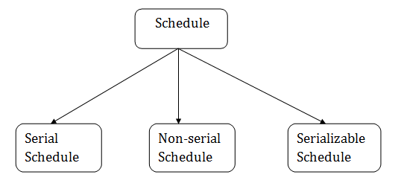
SCHEDULE
A series of operation from one transaction to another transaction is known as schedule. It is used to preserve the order of the operation in each of the individual transaction.

Slide 18
SERIAL SCHEDULE
The serial schedule is a type of schedule where one transaction is executed completely before starting another transaction. In the serial schedule, when the first transaction completes its cycle, then the next transaction is executed.
For example: Suppose there are two transactions T1 and T2 which have some operations. If it has no interleaving of operations, then there are the following two possible outcomes:
Execute all the operations of T1 which was followed by all the operations of T2.
Execute all the operations of T1 which was followed by all the operations of T2.
In the given (a) figure, Schedule A shows the serial schedule where T1 followed by T2.
In the given (b) figure, Schedule B shows the serial schedule where T2 followed by T1.

Slide 19
NON-SERIAL SCHEDULE
If interleaving of operations is allowed, then there will be non-serial schedule.
It contains many possible orders in which the system can execute the individual operations of the transactions.
In the given figure (c) and (d), Schedule C and Schedule D are the non-serial schedules. It has interleaving of operations.

Slide 20
SERIALIZABLE SCHEDULE
The serializability of schedules is used to find non-serial schedules that allow the transaction to execute concurrently without interfering with one another.
It identifies which schedules are correct when executions of the transaction have interleaving of their operations.
A non-serial schedule will be serializable if its result is equal to the result of its transactions executed serially.

Slide 21
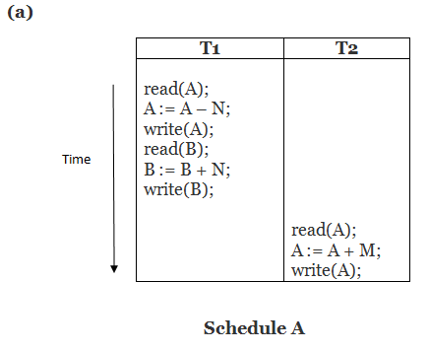
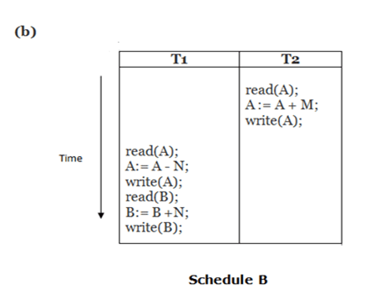
EXAMPLE

Slide 22
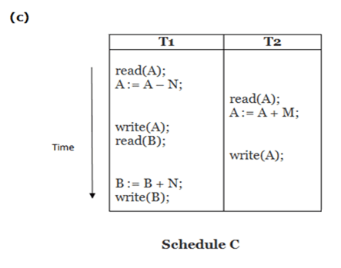
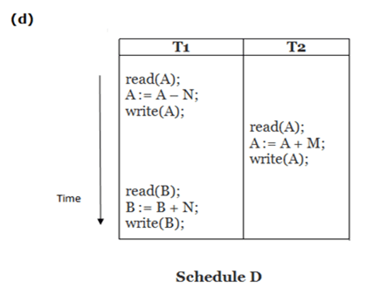
EXAMPLE

Slide 23
In the above example,
Schedule A and Schedule B are serial schedule.
Schedule C and Schedule D are Non-serial schedule.

